Slide 1

The Best and Worst of Games & How to improve their sales
Presented by Hanna Bohannon

Slide 2
Table of contents
Sales over the years
Popular genre
Video game to platform comparison
Nintendo games
Solution to boost sales
conclusion

Slide 3
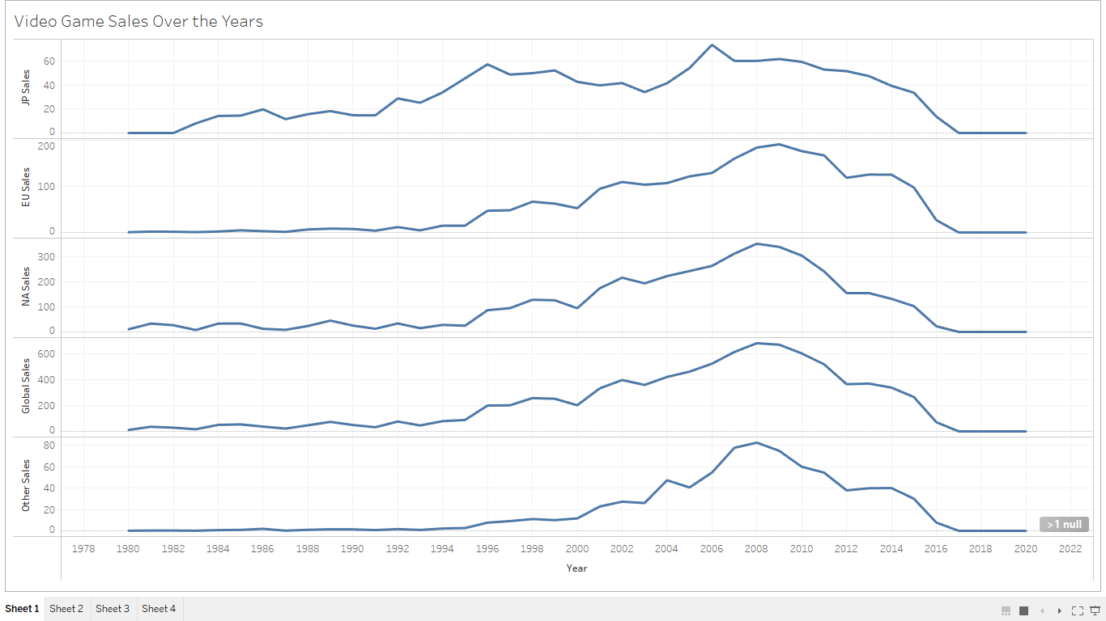
Sales over the years
Over the two decades the sales of games hit a peak that it hasn’t seen again with huge plummet present day. The peak happened between 2006 and 2010 with a post steady decline.

Slide 4
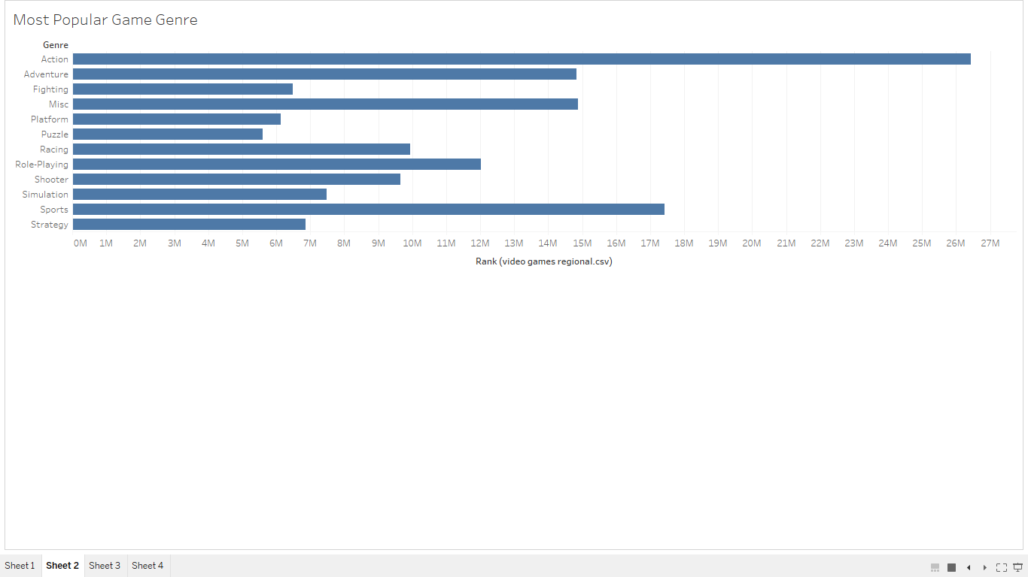
Popular genre
Action genre dominated at 26 million
Sports genre 17 million
Adventure and Miscellaneous genre tied at 14 million

Slide 5
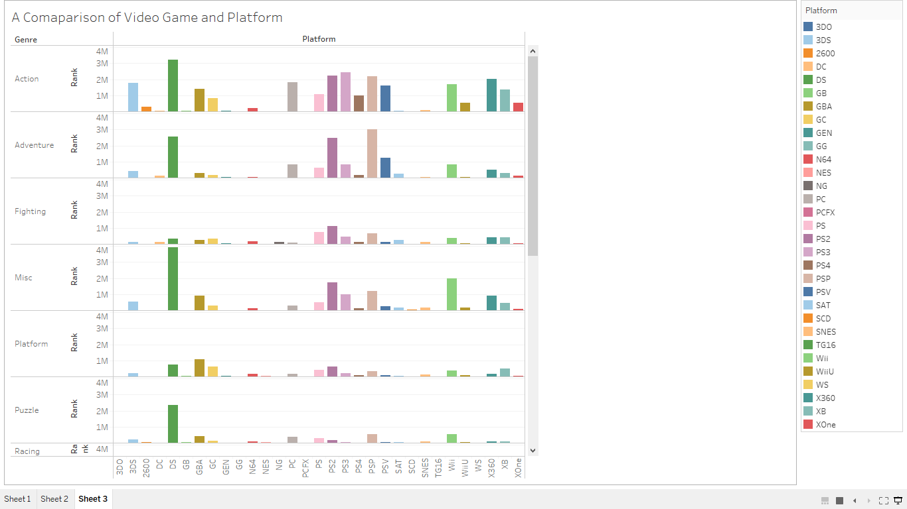
Video game to platform comparison
During the peak years of between 2006-2010 the top two platforms were Sony PS2 and Nintendo DS.

Slide 6
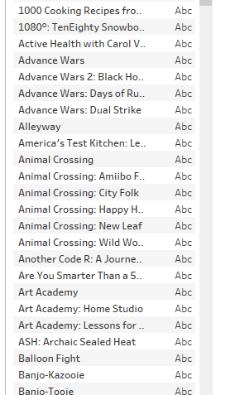
Nintendo games
There were over 5000 Nintendo games alone. With such a variety of games it’s no wonder they’re platform were one of the top played.

Slide 7



Sales boost solutions
Technology has integrated rather well with social media over the years especially with video games and the gaming community. One corner of that community is the YouTube Gaming Community. A surefire way to boost game sales would be to sponsor via some of the top YouTube Gamers such as CoryxKenshin, Jazzy Guns, and Dashie Games. These YouTube Gamer’s channel has millions of subscribers and supporters who will love to play game after watching them play. Early access, giveaways, and special features will also be great incentives for the viewers.

Slide 8
conclusion
The gaming world and its global community has evolved and grown over the years. Along side of it is how the influence to play games has as well. Try before you buy has a whole new meaning and it packed with more entertainment where the consumer get more for their money’s worth.

